Slide 1

Dead Man’s Switch
Using Secret sharing

Slide 2
Introduction to the Death Man's Switch and Shamir's Secret Sharing Scheme
1
Agenda
controlled activation and triggering mechanism.
2
3
Secure Share Distribution
4
Security Challenges
5
Authentication, access control, Use Cases

Slide 3

Introduction to the Death Man's Switch

Slide 4
A Dead Man’s Switch is like a safety backup that kicks in when a person in control can’t respond anymore.
It works by checking regularly if the person is still active like pressing a button, holding a lever, or sending a signal.
If there’s no response within a set time, it triggers an action:
Examples
Stops a train: if the driver lets go of the controls
Sends an alert: if a worker becomes unresponsive
Releases information: if the owner can’t activate it in time

Slide 5

SHAMIR'S SECRET SHARING

Slide 6
What is it:
Shamir’s Secret Sharing Scheme is a (k, n)-threshold cryptographic method that allows a secret to be split into n unique shares, such that:
Any k or more shares can reconstruct the secret
Fewer than k shares reveal absolutely nothing about the secret
It was invented by Adi Shamir (one of the inventors of RSA) in 1979 and is based on polynomial interpolation in finite fields
Uses:
Backup of encryption keys
Multi-party control of secure data (bank vaults, nuclear launch codes, etc.)
Secure distribution of cryptographic credentials

Slide 7

Algorithm

Slide 8
Step-1:
Select:
Secret S∈Zp (convert message to number if needed)
Prime p>max⁡(S,n,any f(x))
n: number of shares to create
k: threshold needed to reconstruct the secret
Step-2:
Generate a random polynomial of degree k−1 over Zp:
f(x)=a0+a1x+a2x2+⋯+ak−1x^k-1(modp)
Set a0=S
Choose a1,a2,…,ak−1∈Z randomly
Step-3:
For each i=1 to n, compute:
Sharei=(i,f(i) mod p)
Distribute these shares to participants.

Slide 9
Step-4:
If less than k shares are available:
Secret cannot be recovered
Trigger backup alert or log failure for audit
May notify administrator or take fail-safe action
STEP-5:
Once the secret S is recovered:
Decrypt file/message
Send to predefined contacts
Publish online or activate emergency protocols

Slide 10

EXAMPLE

Slide 11
Numerical Example:
Given a secret S = 1234, n = 5, k = 3, and a polynomial f(x) = 1234 + 45x + 12x², compute the shares for x = 1 to x = 5?
Solution:
Given that:
S= 1234
N= 5
K= 3
A1=45,A2=12
P=2027 because max n=5 sub in step 2 equation we will get 1759 so P should be greater than 1759.
You need any 3 shares to recover the secret.
Now We randomly choose a polynomial of degree k-1 = 2:
f(x) = a₀ + a₁ x + a₂x² (k=2)
Set a₀ = S
Take a1=45 and a2=12
So equation is: f(x) = 1234+ 45x + 12x²

Slide 12
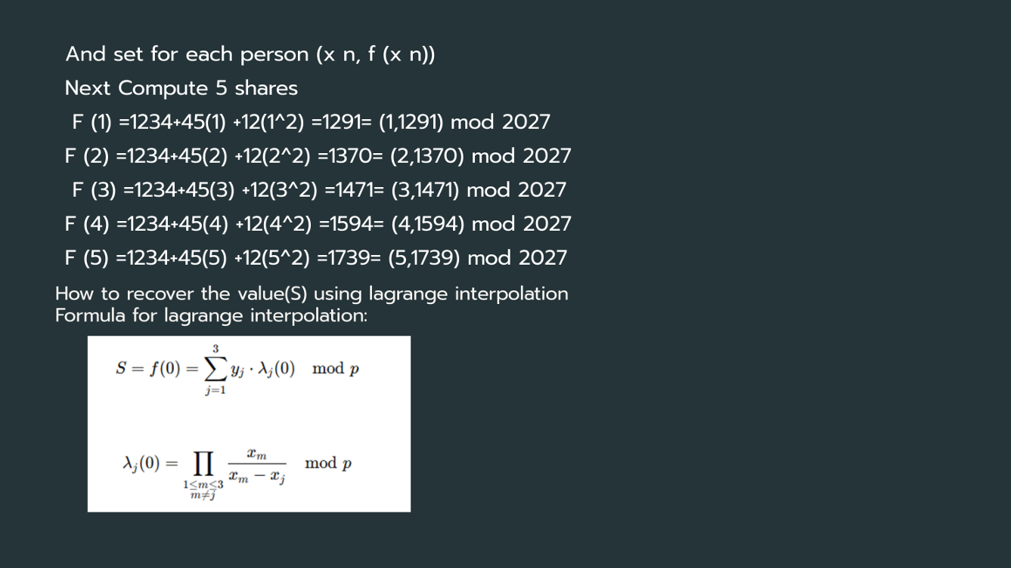

Slide 13
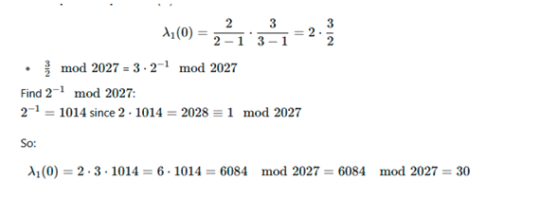
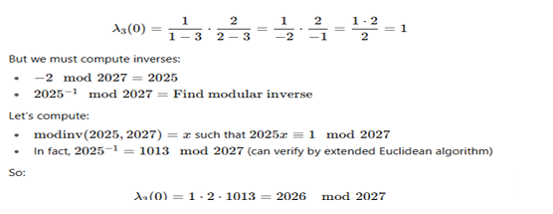
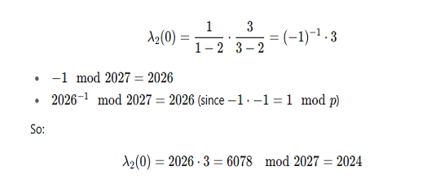
Calculation for lambda values:
(x1=1)
(x3=3)
(x2=2)

Slide 14

At last:
S = (1291 . 3 + 1372 .2024 + 1477 .1) mod 2027
Compute each term:
1291 . 3 = 3873
1372 . 2024 = 2776928
1477 . 1 = 1477
Add:
3873 + 2776928 + 1477 = 2782278
Now compute:
S = 2782278 mod 2027 = 1234
Secret Recovered: S = 1234

Slide 15

controlled activation and triggering mechanism

Slide 16
Controlled Activation
Controlled activation means carefully managing when and how the switch is armed or kept alive.
Key elements include:
Authentication Requirement – Only authorized users can arm or reset the switch.
Arming Protocols – The switch is only activated after following a predefined procedure.
Time-Based Control – Switch remains active for a set period before requiring reactivation.
Threshold Schemes – Multiple trusted users must confirm activation
Triggering Mechanism
The triggering mechanism determines what exactly causes the switch to activate its final action.
Possible triggers:
Inactivity Timeout – If the user fails to send periodic "alive" signals (heartbeat) before the deadline.
Manual Trigger – Activated deliberately by authorized parties in emergencies.
External Data Signals – Based on inputs like loss of network connection, biometric inactivity, or security breach detection.

Slide 17

Secure Share Distribution

Slide 18
Secure Share Distribution for Dead Man’s Switch systems involves splitting sensitive data into encrypted shares, distributing them across secure locations, and allowing authorized to reconstruct the data upon triggering conditions. This process typically uses cryptographic methods like Shamir’s Secret Sharing Scheme encryption to ensure confidentiality.
Why Use Secure Share Distribution?
No single control – One person alone can’t activate it.
Still works if some parts are lost – The system stays safe even if some shares are missing.
Needs group agreement – It starts only when enough people agree.

Slide 19
Worked Example
Let’s say your Dead Man’s Switch system is protecting a system shutdown key.
You want to divide it among 6 officers, where any 4 together can recover it.
Secret (S): 987
Threshold (t): 4
Total Shares (n): 6
Prime (p): 1237 (a prime greater than the secret)
1. Build the Random Polynomial
Since t = 4, we need a degree 3 polynomial:
· 987(the secret)
· 120(random)
· 77(random)
· 210(random)
Polynomial:
f(x) = 987 + 120x + 77x2 + 210x3 (mod1237)

Slide 20
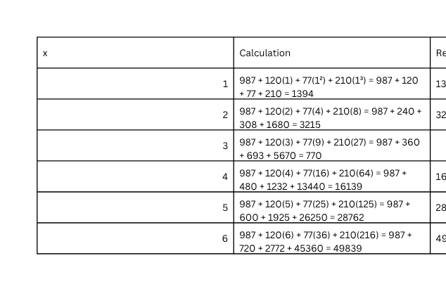
2. Compute Each Share
We compute for x = 1 to 6.
3. Distribute Shares
Each of the 6 officers gets one share:
(1, 157), (2, 741), (3, 770), (4, 68), (5, 401), (6, 479)
4. Reconstruct the Secret
Suppose officers with shares (2, 741), (3, 770), (5, 401), (6, 479) pool their shares.
Using Lagrange interpolation (all calculations modulo 1613):
When computed with modular inverses, this yields:
S = 987

Slide 21
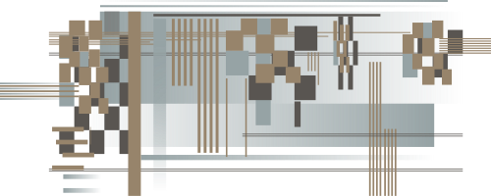
security challenges

Slide 22
Authentication Bypass
Goal: Impersonate the legitimate owner to disable, alter, or trigger the switch.
Methods:
Password cracking, phishing.
Stealing private key.
Deepfake biometrics (e.g., spoofing a face or fingerprint).
Example: Attacker sends a fake “I’m alive” check-in using stolen login details.
Preemptive Disablement
Goal: Prevent the switch from triggering.
Methods:
Server compromise → attacker gains access to the host system and deletes or alters the trigger logic.
Command & control disruption → cutting internet access, taking down the hosting service, or jamming signals.
Clock/timestamp tampering → altering system time so the switch never thinks the trigger time has arrived.
Example: An adversary hacks into the DMS server and resets the “last check-in” timestamp repeatedly to keep it active.

Slide 23

authentication and access control

Slide 24
Authentication
Authentication ensures that only legitimate users can activate, configure, or disable the switch.
Common authentication methods:
Password-based login
Biometric verification
Two-Factor Authentication
Multi-factor authentication
Access Control
Access control determines who has what level of permission:
Role-Based Access Control – Only authorized users can modify DMS settings
Time based access - The system checks for user interaction at scheduled intervals.

Slide 25
USE CASES

Slide 26
1. Digital Asset Management
Cryptocurrency Wallets: Automatic transfer of crypto assets to designated beneficiaries after a period of inactivity
2. Personal Data Legacy
Social Media: Platforms like Facebook already implement memorialization features
Email/Cloud: Google's Inactive Account Manager releases data after 18 months inactivity
3. Biometric-Integrated Systems
Health Monitoring: Triggered by cessation of vital signs (smartwatch ECG/pulse data)
4. Smart Contract Evolution
Decentralized Autonomous Organizations (DAOs):
Automatic treasury redistribution if founders disappear
Emergency protocol changes after prolonged governance inactivity

